Slide 1

Sentiment and Emotion Analysis

Slide 2
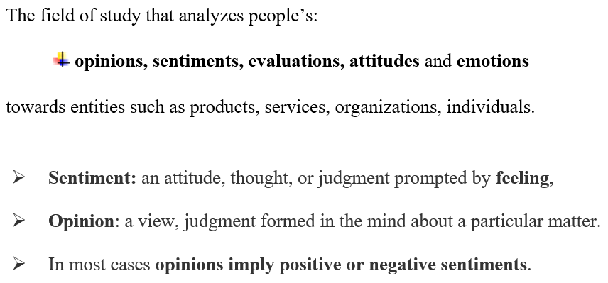
Sentiment analysis (opinion mining)

Slide 3
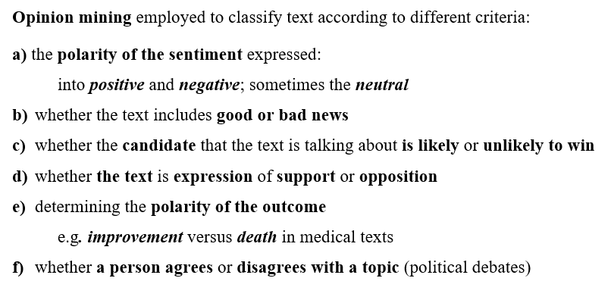

Slide 4
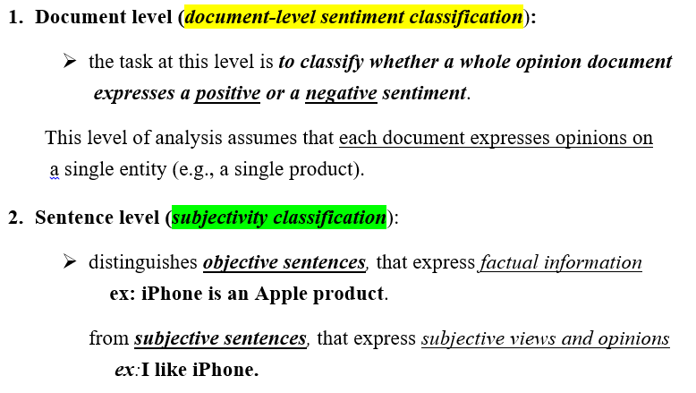
levels of sentiment analysis

Slide 5
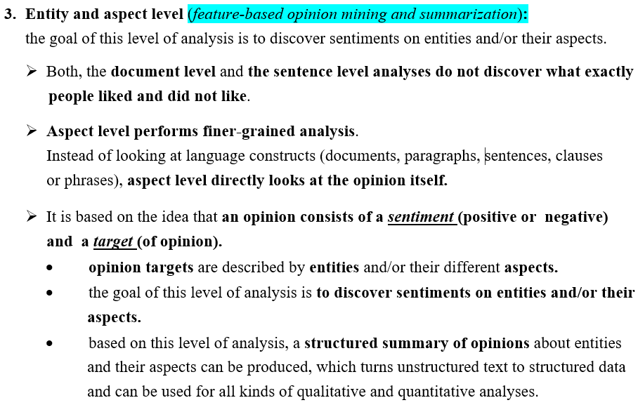
levels of sentiment analysis (contd.)

Slide 6
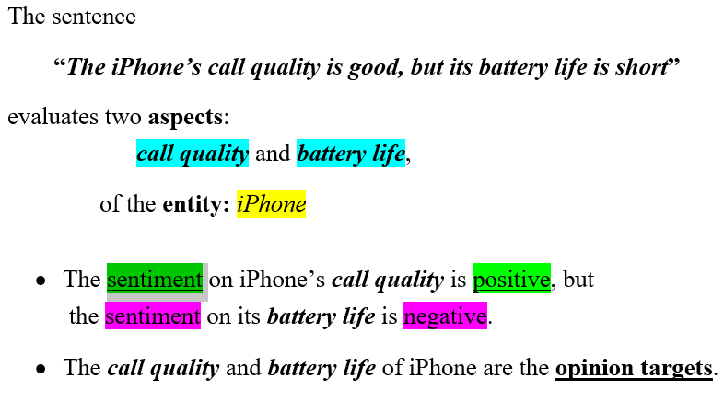
Example:

Slide 7
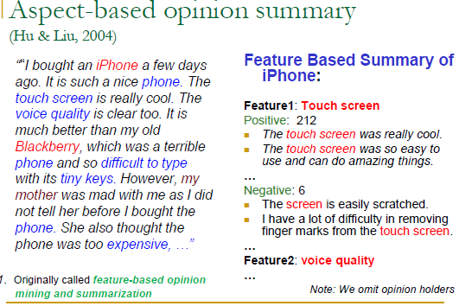

Slide 8
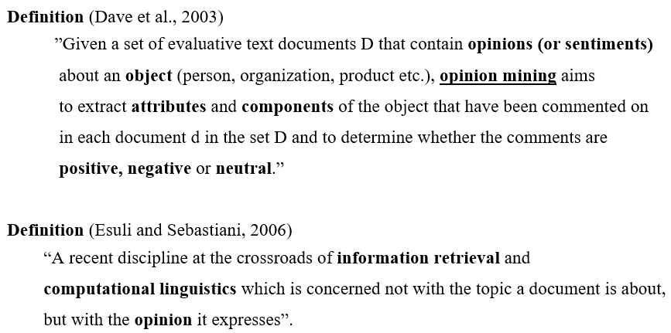
Opinion Mining

Slide 9
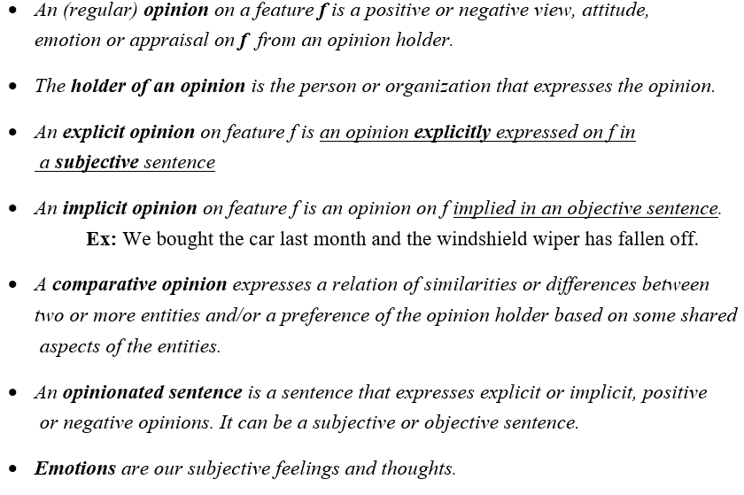
Definitions (Liu, 2010)

Slide 10
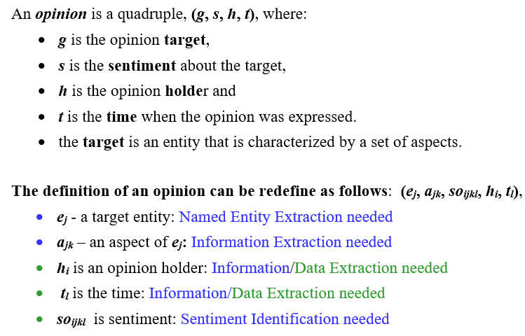
Opinion – formal definition

Slide 11
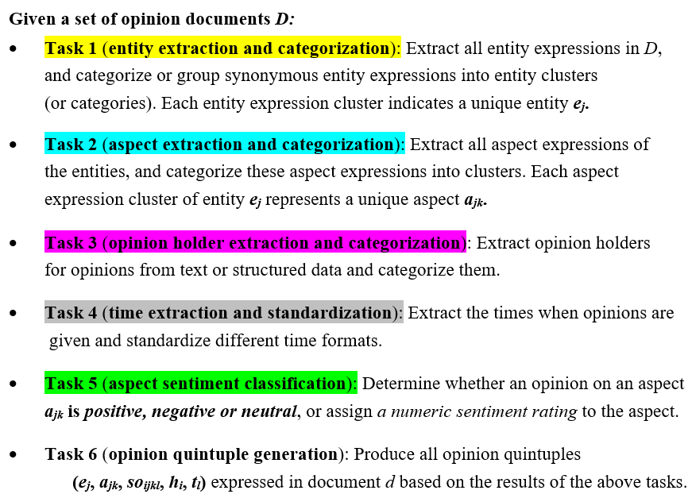
sentiment analysis (opinion mining) - 6 main tasks.

Slide 12
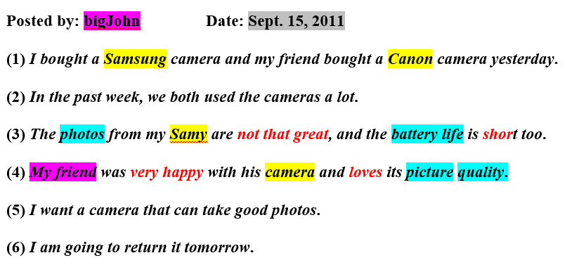
Example:

Slide 13
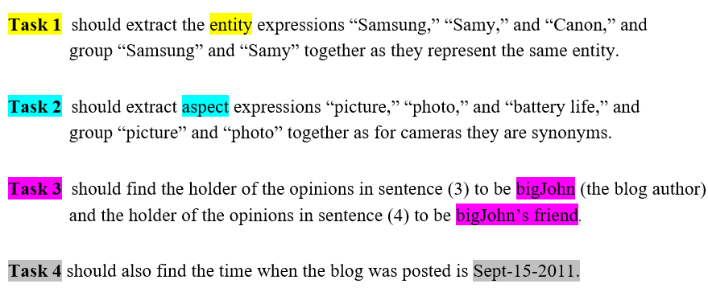
Solving Tasks:

Slide 14
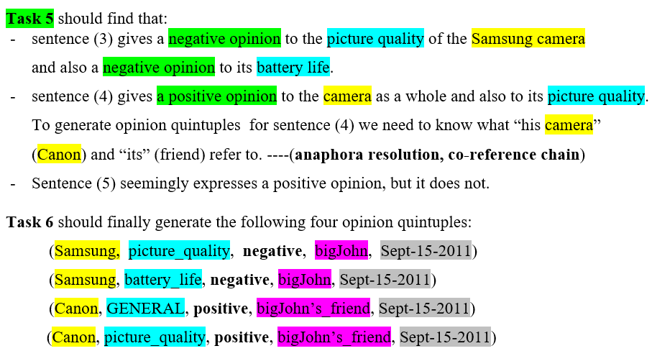
Solving Tasks:

Slide 15
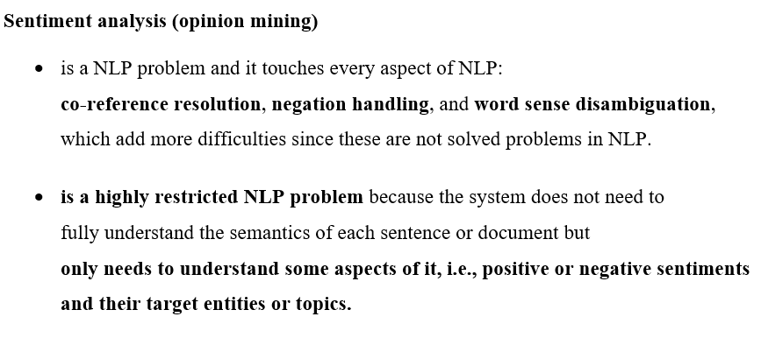

Slide 16
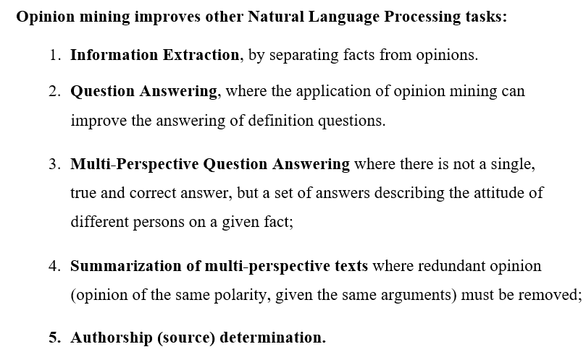

Slide 17
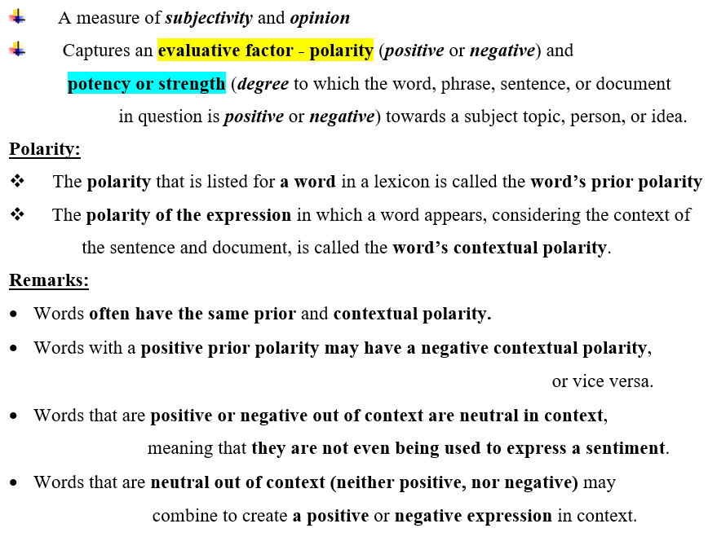
Semantic orientation (SO)

Slide 18
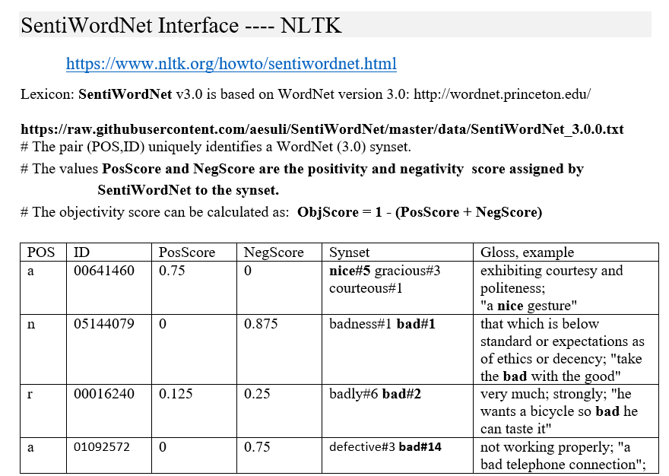
SentiWordNET

Slide 19

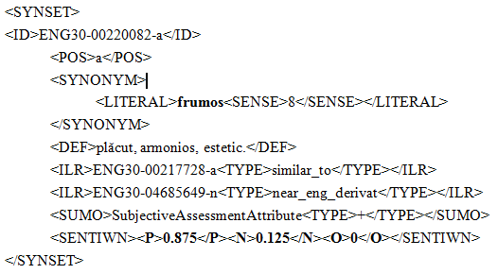
Polarity scores in RoWordNet

Slide 20
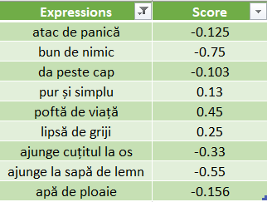
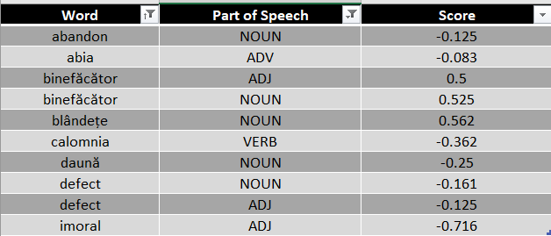
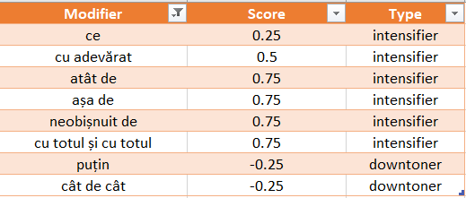
Romanian Opinion Lexicon

Slide 21
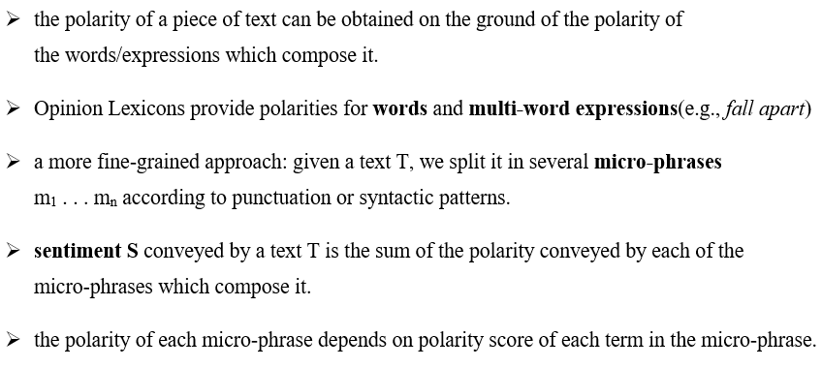
Lexicon-based approach for sentiment classification

Slide 22
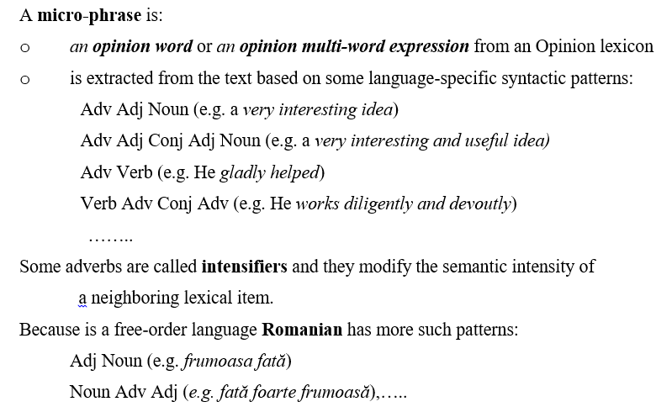
Lexicon-based approach for sentiment classification

Slide 23
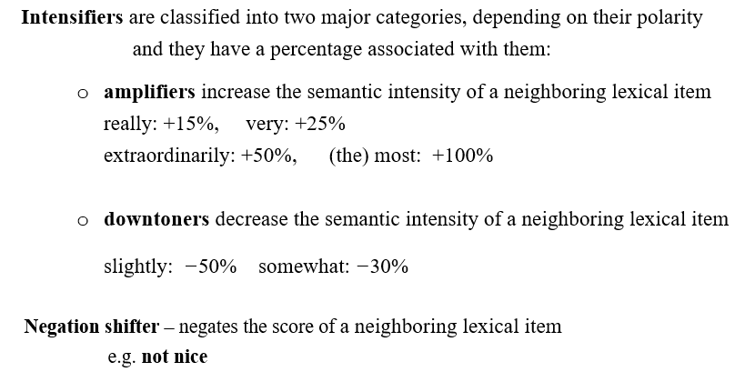
Lexicon-based approach for sentiment classification

Slide 24
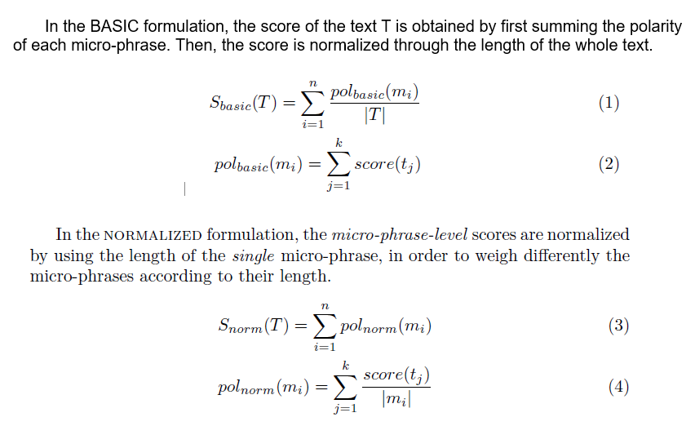
4 approaches to calculating the polarity score of a text

Slide 25
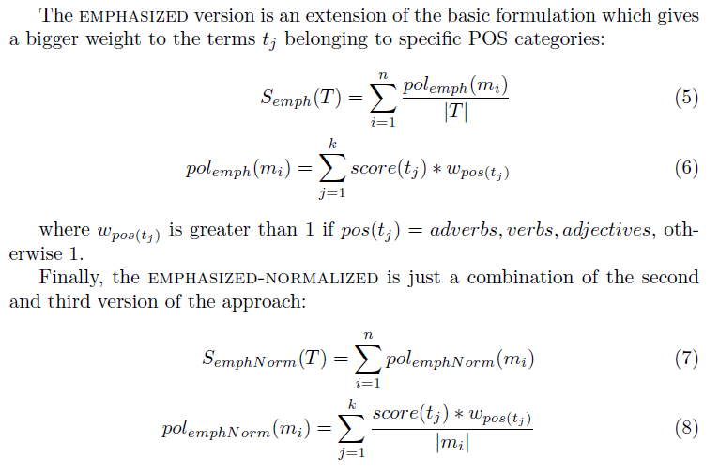
4 approaches to calculating the polarity score of a text

Slide 26
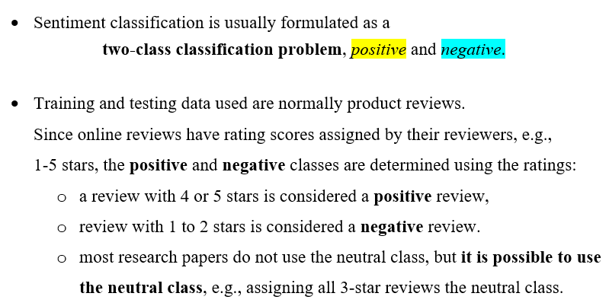
Sentiment Classification Using Supervised Learning

Slide 27
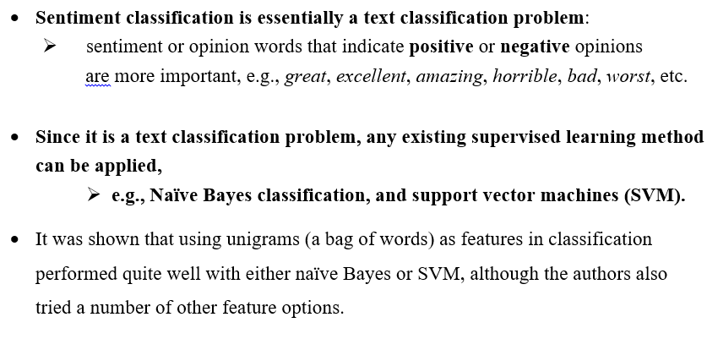

Slide 28
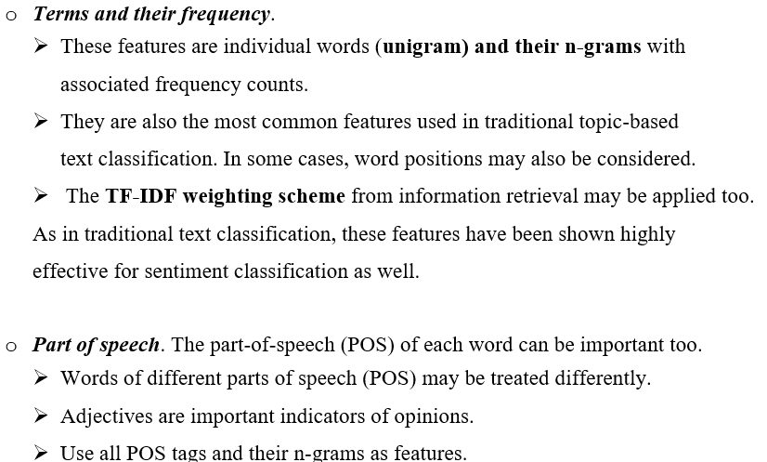
features used in classification:

Slide 29
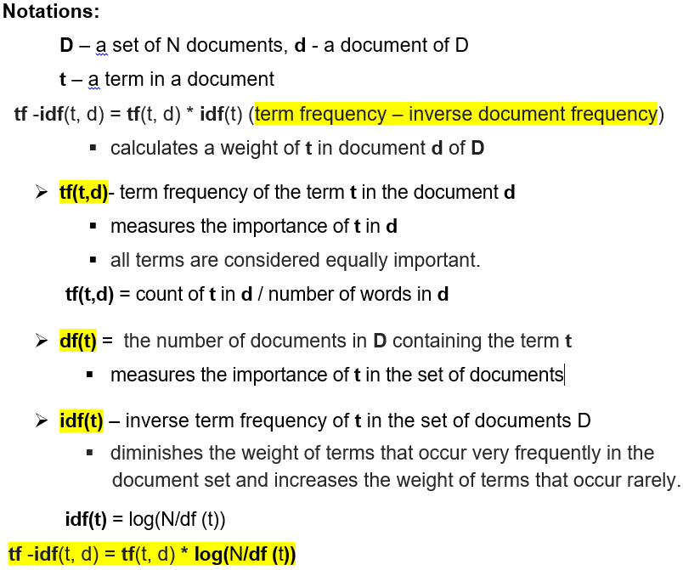
TF-IDF Weighting Scheme

Slide 30
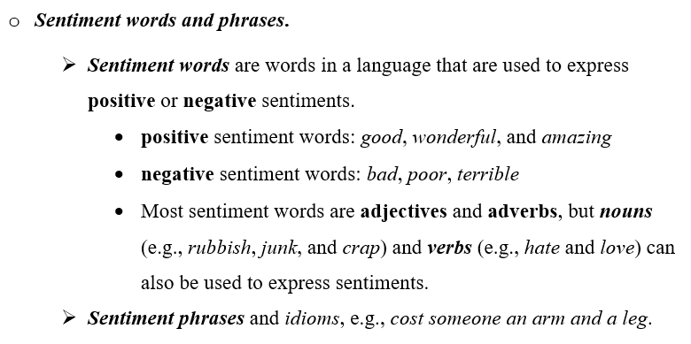
features used in classification:

Slide 31
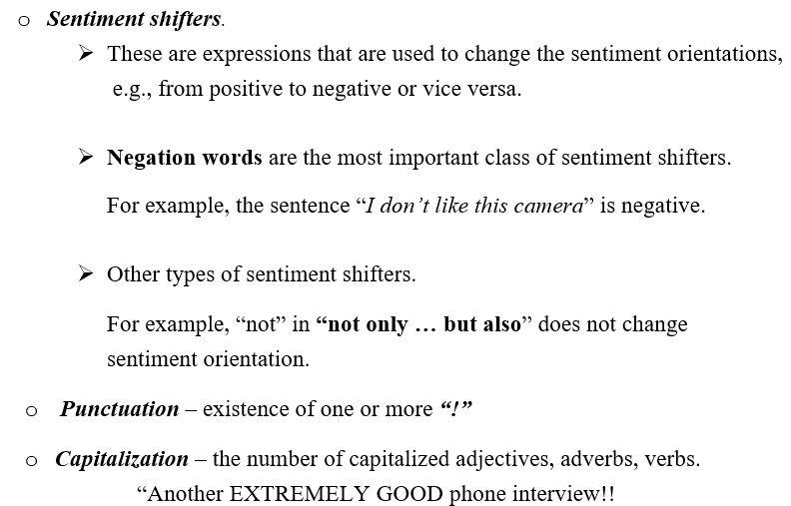
features used in classification

Slide 32
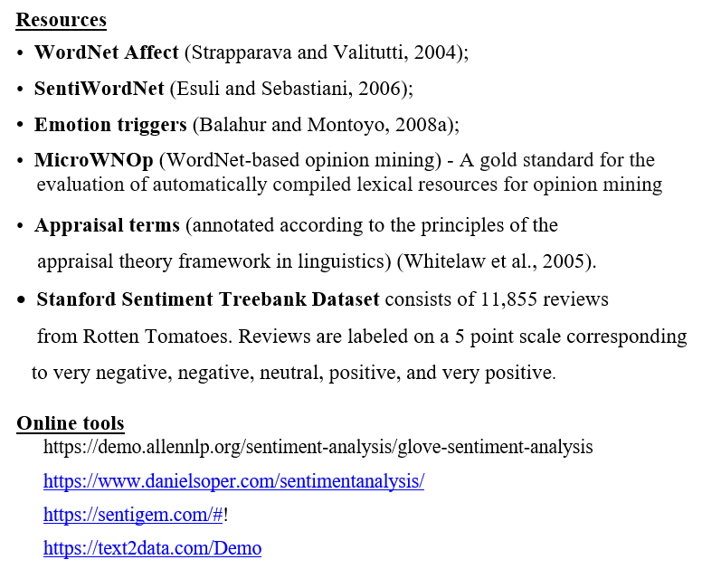

Slide 33
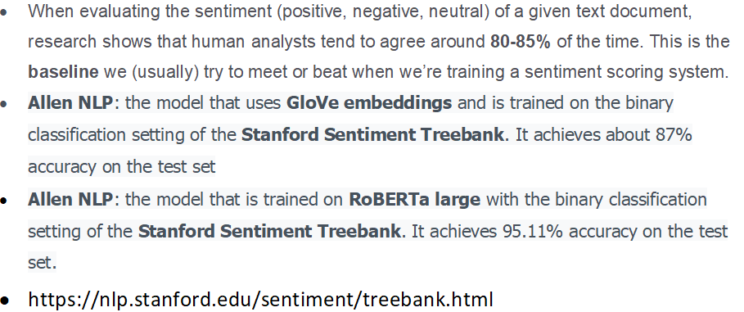
Performance in Sentiment Analysis

Slide 34
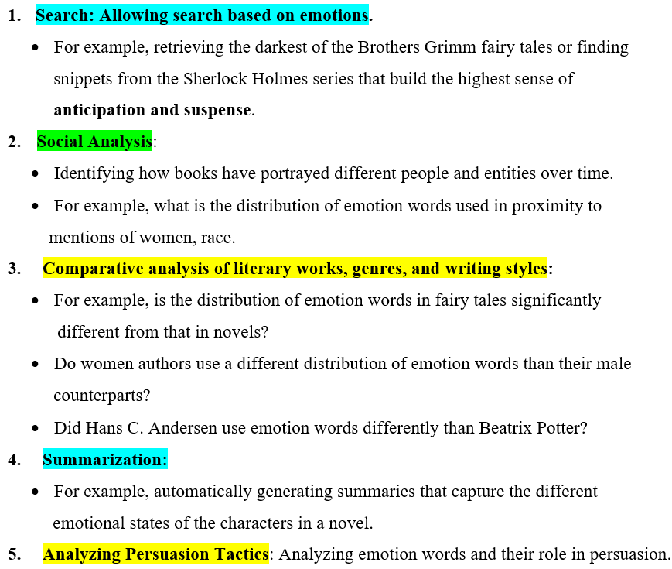
Emotion analysis - purposes

Slide 35
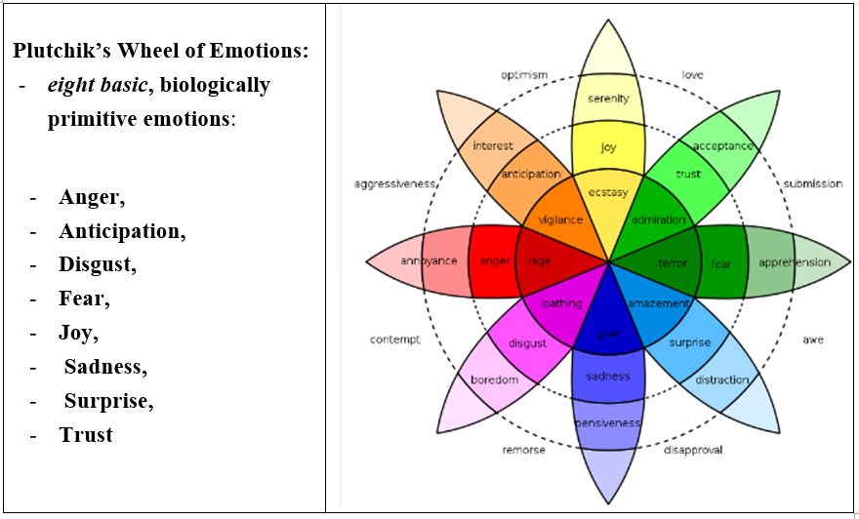
Theory of emotion Plutchik MODEL – A categorical model

Slide 36
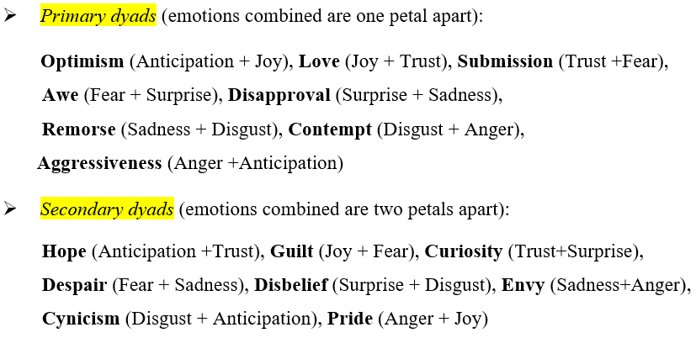
Derived emotions

Slide 37
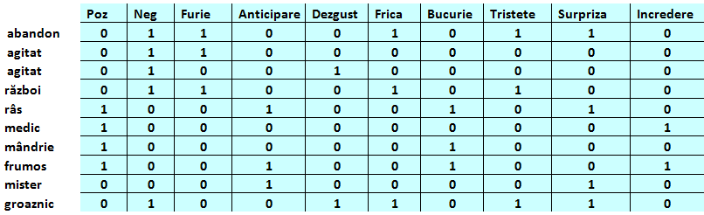
RoEmoLex - Lexicon de emoţii (~8000 entries)

Slide 38
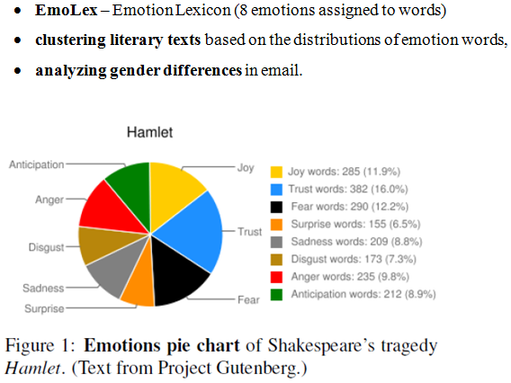
Emotion analysis

Slide 39
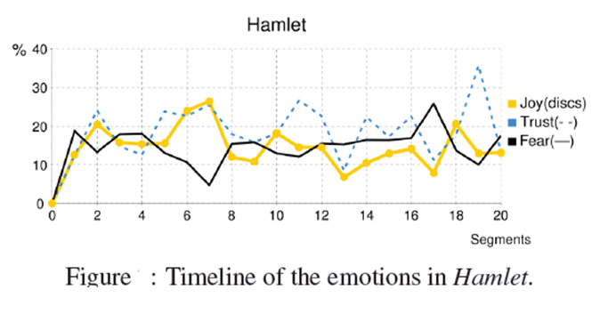

Slide 40
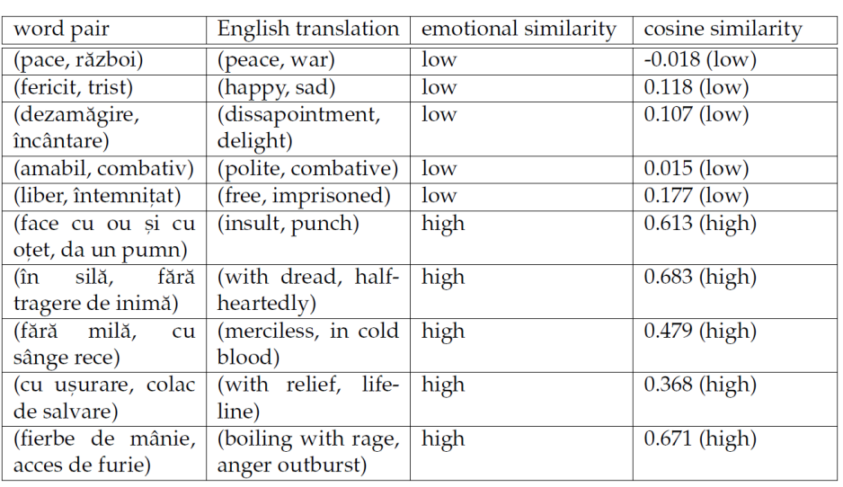
Emotion Embeddings built on CoRoLa Distant Supervision Dataset

Slide 41
